Slide 1
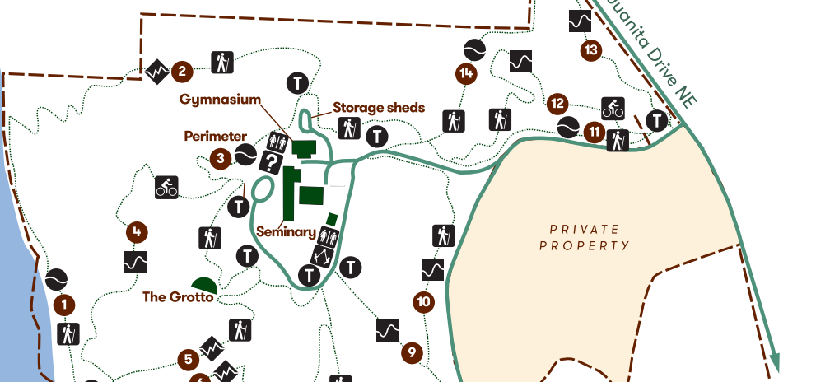
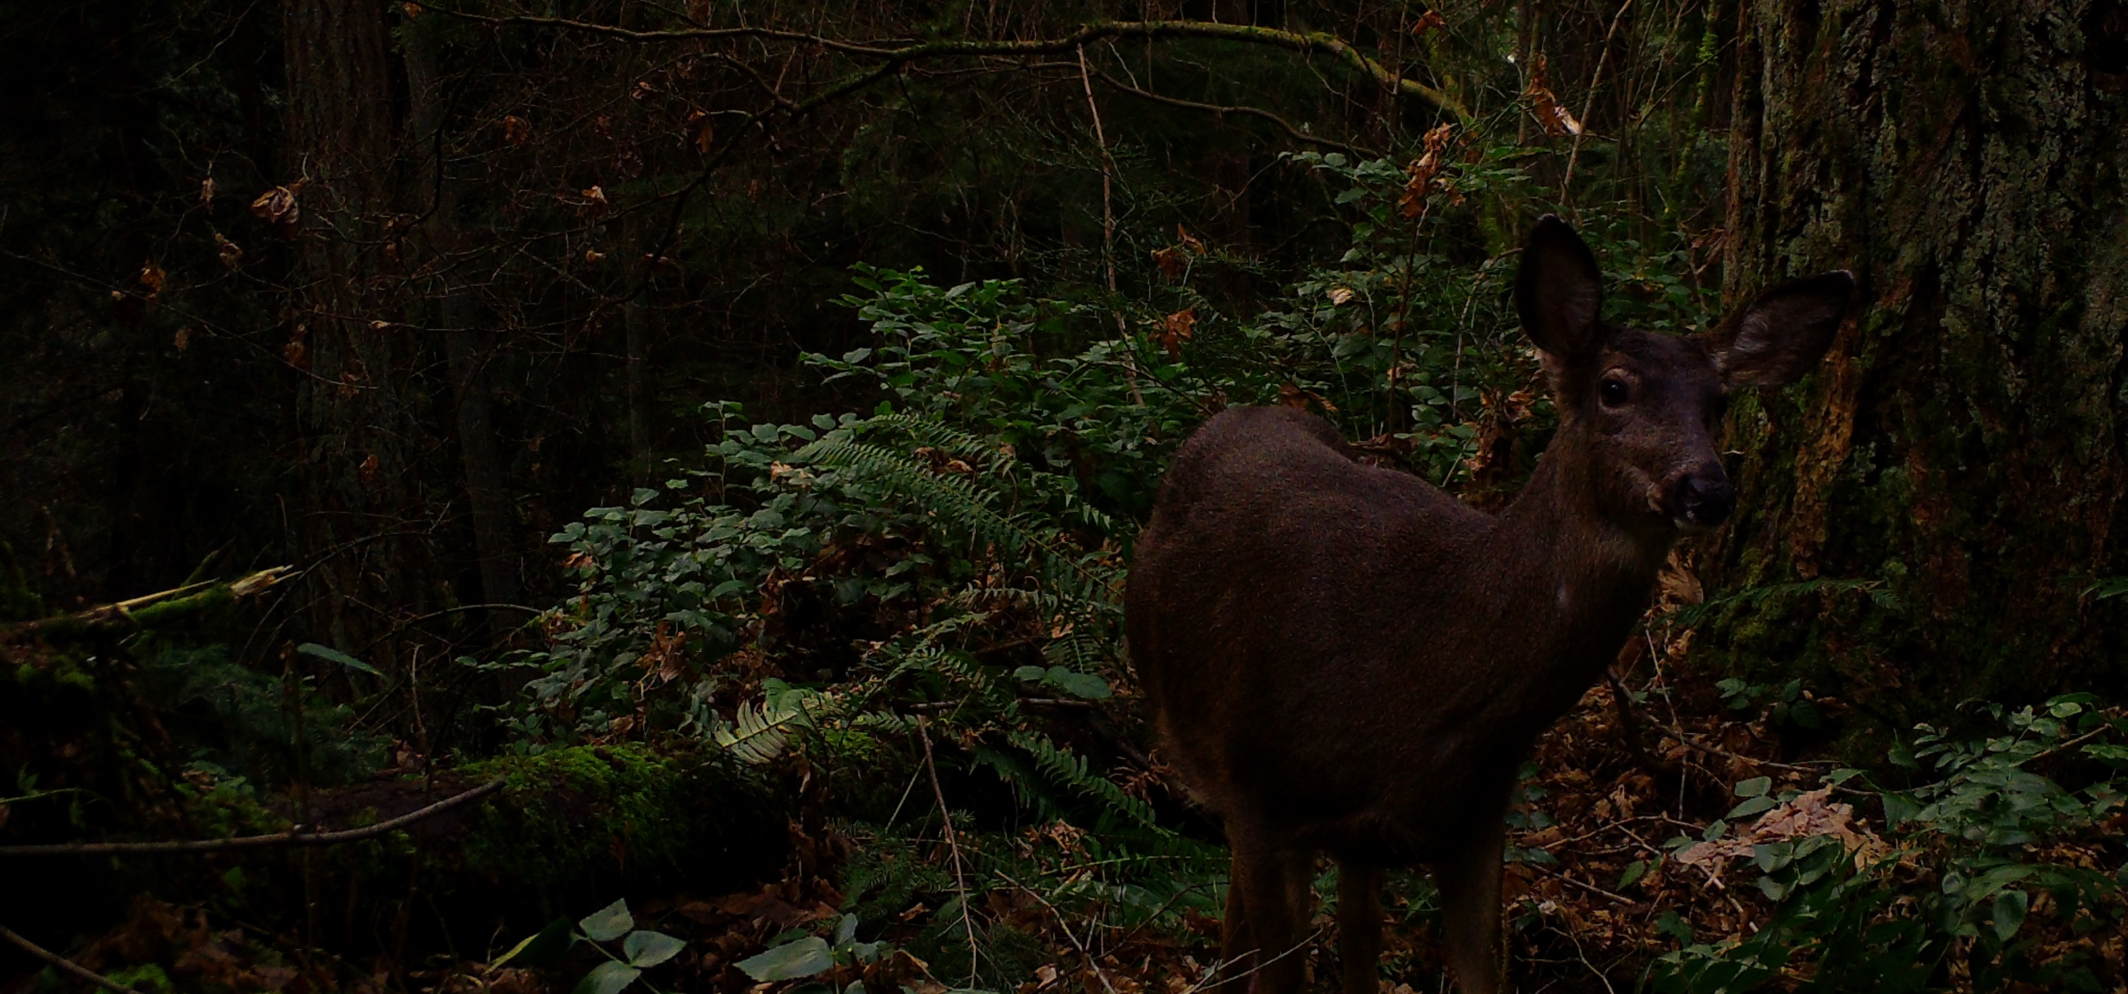
Wildlife Impacts of Recreational Trails and Trail Use in a Heavily Used Green Space
University of Washington Bothell
Winter 2021
Dr. David Stokes
Zayd Almallah, Stefanie Castro, Sylvia Joo, Melody Kazemini

